Slide 1
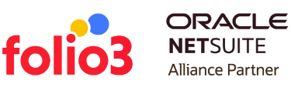
Digital Transformation in Real Estate and The Role of ERP

Slide 2

Agenda
Why Does Modern ERP Matters To Your Business?
Advantages ERP software development for real estate
NetSuite Property Management Solution
Why NetSuite’s Property Management Solution?
Benefits of Our Real Estate Solution?
The Future Of Real Estate
The Future Of Real Estate Technology
Global Real Estate Management System Market Growth Status 2022-2028
How to Adapt, Grow and Prosper in Today’s Real Estate Market

Slide 3
Why Does Modern ERP Matters To Your Business?
Due to the constant speed of change, business frameworks are being undermined faster than ever. Every company must continually merge income streams from a wide range of products and subscriptions to stay afloat. Every transaction now prioritizes the customer experience and those who can identify new opportunities and anticipate changing expectations will succeed. As a result, a future-focused customer-centric suite aids the organization's ability to adapt to changing customer needs and improve the customer experience.

Slide 4
Connects Front & Back Office
Maintaining the whole customer lifecycle on a centralized platform is crucial to establishing a business that promotes customer devotion. You can comprehensively understand your consumers by connecting your back-office functions (ERP), financials, billing, and product and service delivery to your front office (CRM).
Decrease Operational Cost
Modern ERP software minimizes operating and organizational costs by maintaining existing assets while reducing them. Businesses can use ERP technology to monitor their operations more effectively by obtaining data to make smarter, faster decisions.

Slide 5
Improved Productivity
Using reports, document transfers, and other regular processes, workforce efficiency is reduced by wasting time. ERP allows these processes to be completed in a single platform, allowing employees to focus on more important issues, resulting in higher workforce efficiency. With ERP, employees will have a streamlined flow of information, boosting productivity and reducing operational costs.
Making Realistic, Accurate Forecasts
Precise prediction is one of the most vital factors in business growth. Businesses must receive up-to-date, comprehensive, accurate data in real time. Filters and predictive analytics are utilized in ERP reporting systems to eliminate data inconsistencies. Accurate and precise business analyses will assist decision-makers in making the best choices.

Slide 6
Advantages ERP software development for real estate

Slide 7

Establish A Comprehensive Property Management Infrastructure
An ERP solution can manage any real estate property in a single, centralized platform. An ERP-based mobile solution may also be created to track real estate companies' construction development and on-site operations. An ERP-based mobile solution can also be used to manage lease requirements between landlords and tenants, a common feature of ERP technology.
Reduced Leasing Complexities
It's simple to manage lease agreements using real estate ERP software. Property managers may manage lease-related paperwork, complicated legislative processes, and administrative duties. Using centralized business software, fair transactions are accomplished.

Slide 8
Streamlined project management
Facilitate Secured Transactions
Real estate ERP software can determine the number of resources and financial costs throughout the process. Using a centralized platform, project managers can efficiently allocate expenses and resources. Using ERP software to meet project deadlines reduces inefficiency and costs.
Real estate ERP software is designed to perform safe transactions and optimize financial information. Real estate companies can utilize ERP software to obtain departmental access to construction data to obtain valuable and critical financial reports.
Maximize Marketing Effort
An ERP solution with innovative marketing tools can be used to optimize marketing campaigns and boost conversion rates. Businesses can customize their marketing strategies using an AI-powered ERP solution according to their customer's perceptions.

Slide 9
Improves Closing Thoughts
Small businesses that desire to boost sales and revenue might benefit from ERP software. ERP reduces expenses and improves cash flow visibility, improving productivity, efficiency, and sales. While conventional marketing tactics are often ineffective at reaching the target audience and attracting investors, ERP enables effective marketing. It is a fantastic tool for increasing productivity, efficiency, sales, business growth, and expansion due to its ability to reach the target market and attract investors.
Automate Business Processes
Real estate businesses can save a lot of time and money. Using ERP in real estate can help preserve time and money. Digital data can be centralized, and automated business management can assist real estate entities in maintaining efficient operations. Even more, efficiency will be achieved with automated systems. ERP software can also help manage real estate websites.

Slide 10
Enhance Data Security
Real estate businesses often preserve critical data about their clients. ERP has a firewall to prevent data breaches that stores all information in a database system that is highly secure since it keeps track of all activities. The most significant benefit of an ERP system is its dual nature of accessibility and data protection. Real estate ERP software safeguards data from outside interference by restricting access to authorized users.
Provides Real Time Information
An ERP system can help real estate firms keep up with the data as they grow. Data processing and updating must be carried out efficiently and precisely with ERP systems. Inaccurate data may result in a company's poor return on investment. ERP systems are adept at maintaining a wide range of data points and ensuring that they are updated in real-time, keeping all stakeholders informed.

Slide 11
About NetSuite
One unified business management suite
We encompass ERP/Financials, CRM, and ecommerce for more than 27,000 customers.

Slide 12
NetSuite Property Management Solution
Folio3’s Property Management Solution within Oracle NetSuite is a scalable platform that simplifies the most frequent procedures, including property creation, tenant management, contract creation, rent collection, and revenue recognition for Real Estate companies. Because the property solution is incorporated in NetSuite, businesses can benefit from the wide range of ERP features covering all aspects of company operations.

Slide 13
Why NetSuite’s Property Management Solution?

Slide 14

Leads, Opportunities & Quotes Management
You can manage the contract start and end dates, duration, additional charges, and the automatic calculation of rent and security deposits in quotes.
Export contracts in the format of your choice as a pdf document.
Define approval authorities and approvals process for Quotes.
Add Terms and Conditions to Quotes

Slide 15
Contract Management for Tenancy, Lease & Sale
Contract creation automatically checks the property's internal and physical status for Contracts Management.
Payments/installments can be automatically created based on payment mode, contract amount, and duration.
Property managers, owners, and tenants can receive automated email notifications.
Establish contract approval authorities and approval processes.

Slide 16
Support & Maintenance Request Management
Live Dashboard
Track and handle service/maintenance requests in NetSuite. Track service/maintenance requests related to any property from a contract, property, and tenant/lessee perspective. Monitor maintenance request adherence to pre-set KPIs in NetSuite.
This real-time Property Occupancy Ratio dashboard displays the details for each property, including occupancy rates, based on the signed contracts.

Slide 17
Financial Accounting
The system provides for the generation and printing of customer receipts for payments made by tenants/lessees/buyers. With one click, you can generate and print all payments based on the contract's payment schedule (Noe, 2013). You can also create Revenue Recognition schedules in the GL journal entries for costs made against invoices. Revenue Recognition schedules can be generated according to from/to date, subsidiary, branch, and location, all recorded in the GL journal entry. Automatically generate Sales Orders (Contracts) against quotes. Automatically register Invoices against the relevant contracts. Automatically send emails to inform tenants/lessees/buyers that they've received an invoice. Automatically record payments against the relevant invoices.

Slide 18

Benefits of Our Real Estate Solution?
Powerful property management, sales, and commercial accounting workflows help you save time and money.
It provides traditional property management services and insight into the commercial real estate market.
It offers traditional property management services, business intelligence, and premium insight.
Get the information you need to make intelligent business decisions, and gain insight into the commercial real estate market.

Slide 19

The Future Of Real Estate
The future of real estate will be driven by new technologies, buyer-agent relationships, and changing demographics. Real estate investors will need to adapt to these alterations. The industry is shifting significantly by using new software to shorten closing times, online listing sites that produce knowledgeable consumers, and new age groups entering the real estate market. Even forecasters with expertise anticipate future market changes.

Slide 20

The Future Of Real Estate Technology
The sudden influx of capital into the real estate industry signals that the sector will experience significant transformations thanks to new digital resources. Investors should be particularly wary of the implications of online property listing platforms, smartphone applications, virtual reality, and blockchain technology.

Slide 21

Global Real Estate Management System Market Growth Status 2022-2028
The global Real Estate Management System market is estimated to be USD1.0 billion in 2028, growing at a CAGR of 2.5% from 2022 to 2028. With the fastest-growing countries' data, the driving factors, dynamics, and leading manufacturers in the Real Estate Management System market are forecast for 2022-2028.

Slide 22
How to Adapt, Grow and Prosper in Today’s Real Estate Market
The real estate profession has constantly been changing and has seen new business models, technology, methods, and different markets throughout history. Develop a strategy to succeed in today's real estate market.
Welcome change
Significant shifts are occurring in the business world, and you can't stop them. They are driven by market forces, new attitudes, and technologies far more extensive than any of us. Instead of resisting new and unique things, try to comprehend why they are changing and figure out how to adapt and change your company to benefit from them.
Learn and grow
It's simpler than ever before to get information. Make sure to set aside time each week to grow and learn. You spend just one or two hours a week learning more about your profession and how it will alter your business, perspective, and profit over a year.

Slide 23
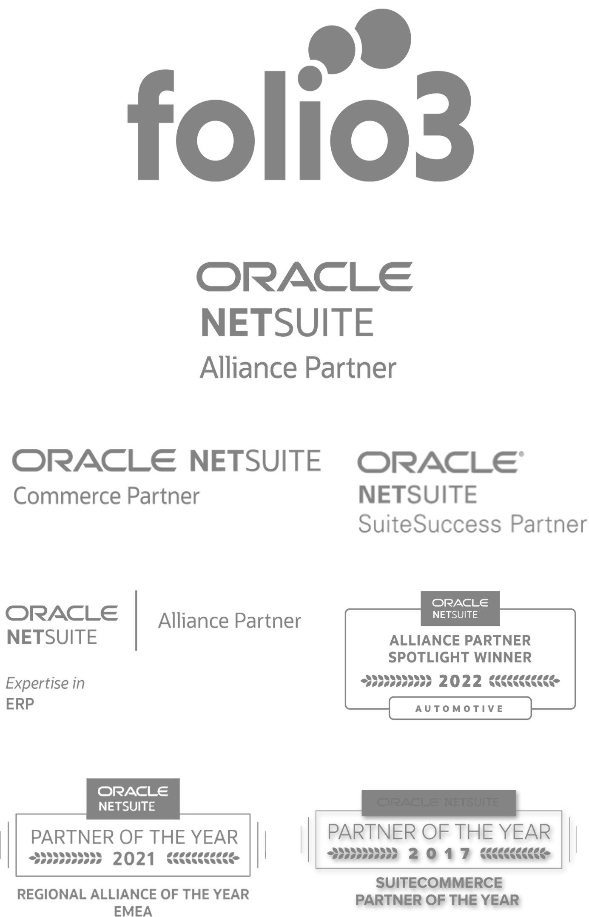
About Folio3
Folio3 is a NetSuite Alliance Partner for NetSuite Implementation, Customization, and Integration with deep domain expertise. Whether you're a Fortune 500 company looking to mobile-enable enterprise processes or a start-up squashing the status quo, we help you deliver your innovation.

Slide 24

Talk to us
Email Address
netsuite.sales@folio3.com
Phone Number
+1 (408) 365-4638
Website Address
Netsuite.folio3.com

Slide 25
THANK YOU

