Slide 1
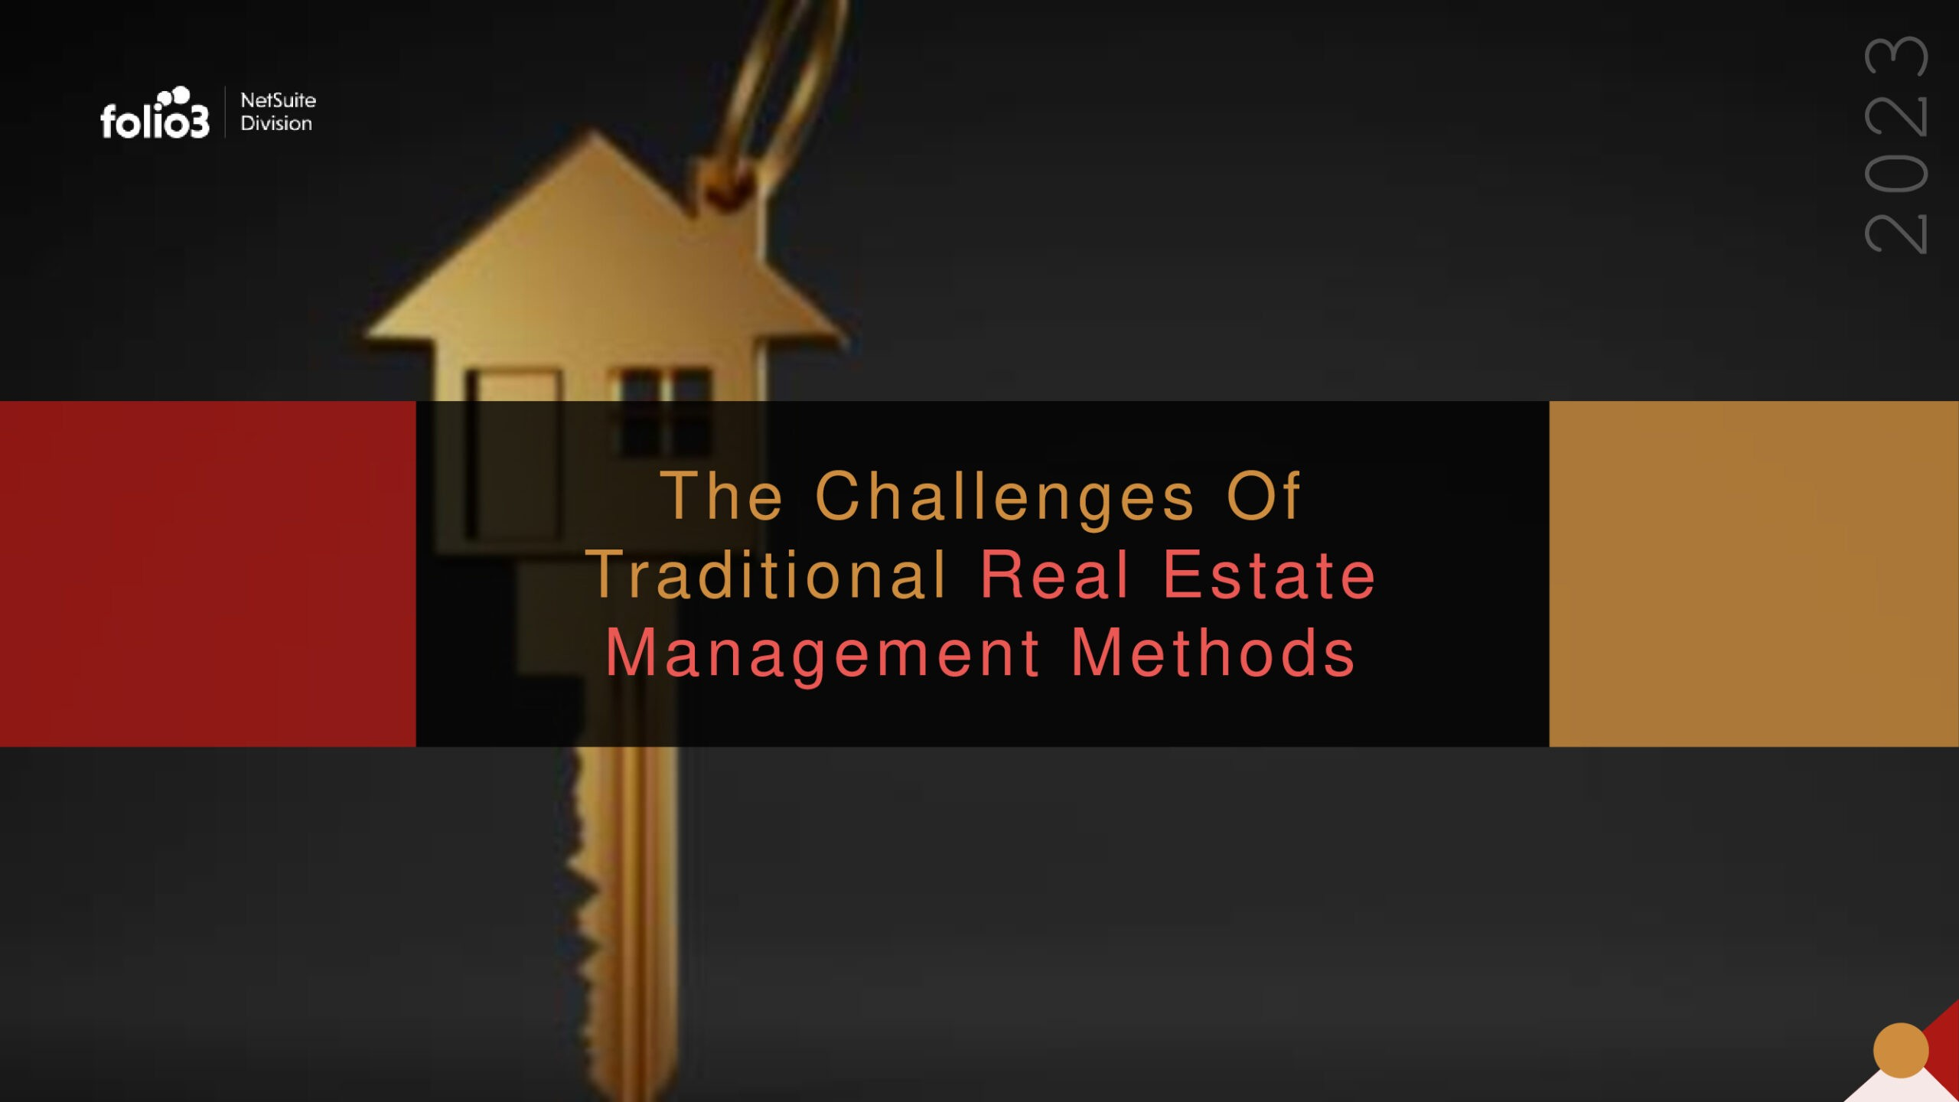

Slide 2


foh.o•3
ORACLE
NETSUITE
Alliance Partner
A ge nda
Real Estate Management
Common Problems Faced When Using Traditional Methods
How to overcome These Challenges
How can Folio3 help?
Folio3's All-in-One Property Management Solution
About NetSuite
Benefits
Features Conclusion

Slide 3



tt•
ORACLE
NETSUITE
Alhonce Portner
foho3
Re a l Estate Ma na ge me nt
The process of overseeing and maintaining properties owned by an individual or a company. Real Estate Managers are
responsible for various tasks, including property maintenance,tenant relations, rent collection,financial management,and marketing.

Slide 4
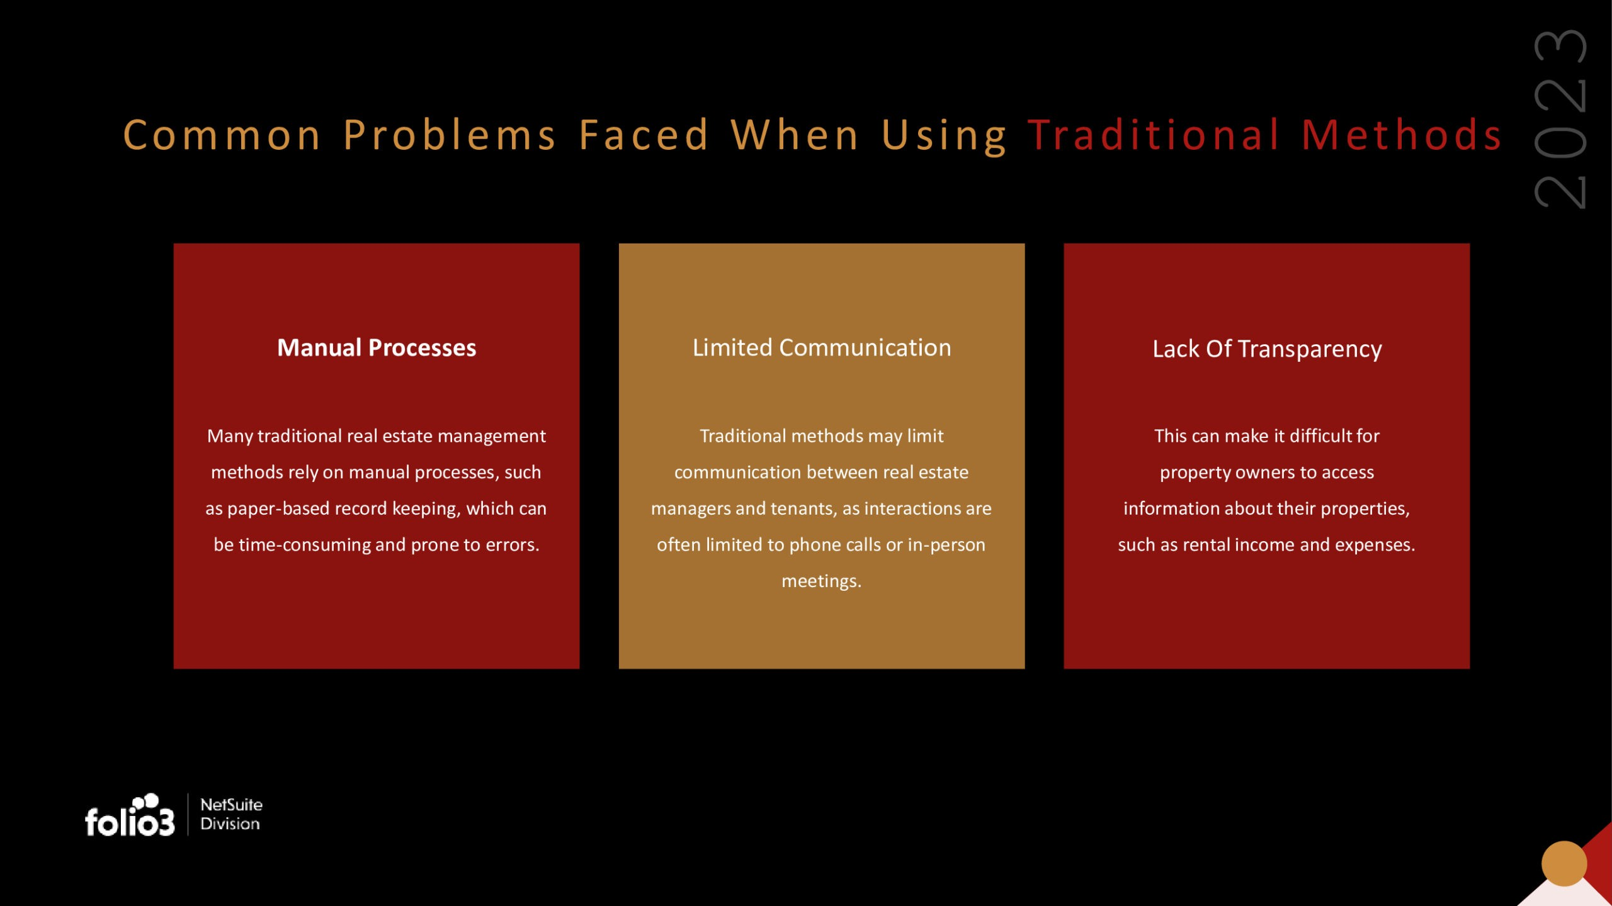

Slide 5
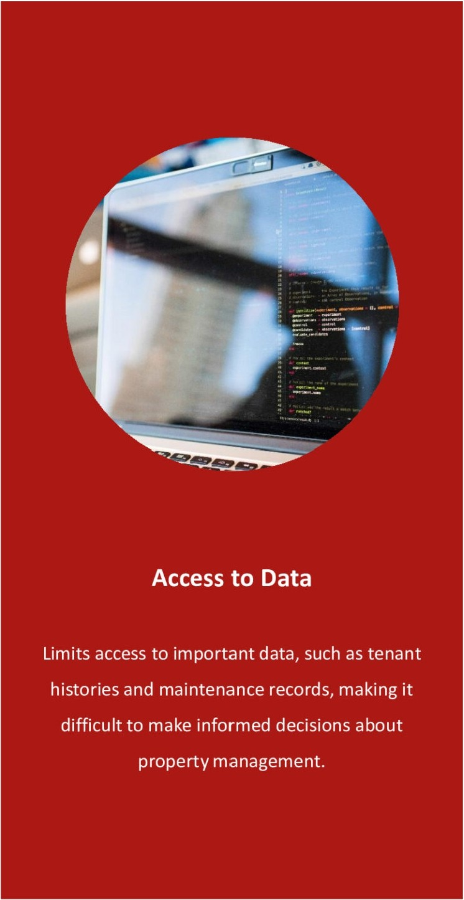


foll.o•3
ORACLE
NETSUITE
Alliance Penner
Difficulty Scaling
Costly and Time-Consuming Maintenance
Traditional methods can make it difficult to
It can result in expensive and time-consum ing
manage many properties efficiently,as each
maintenance issues,as problems may only be
property must be managed individually.
identified once,they become serious.

Slide 6

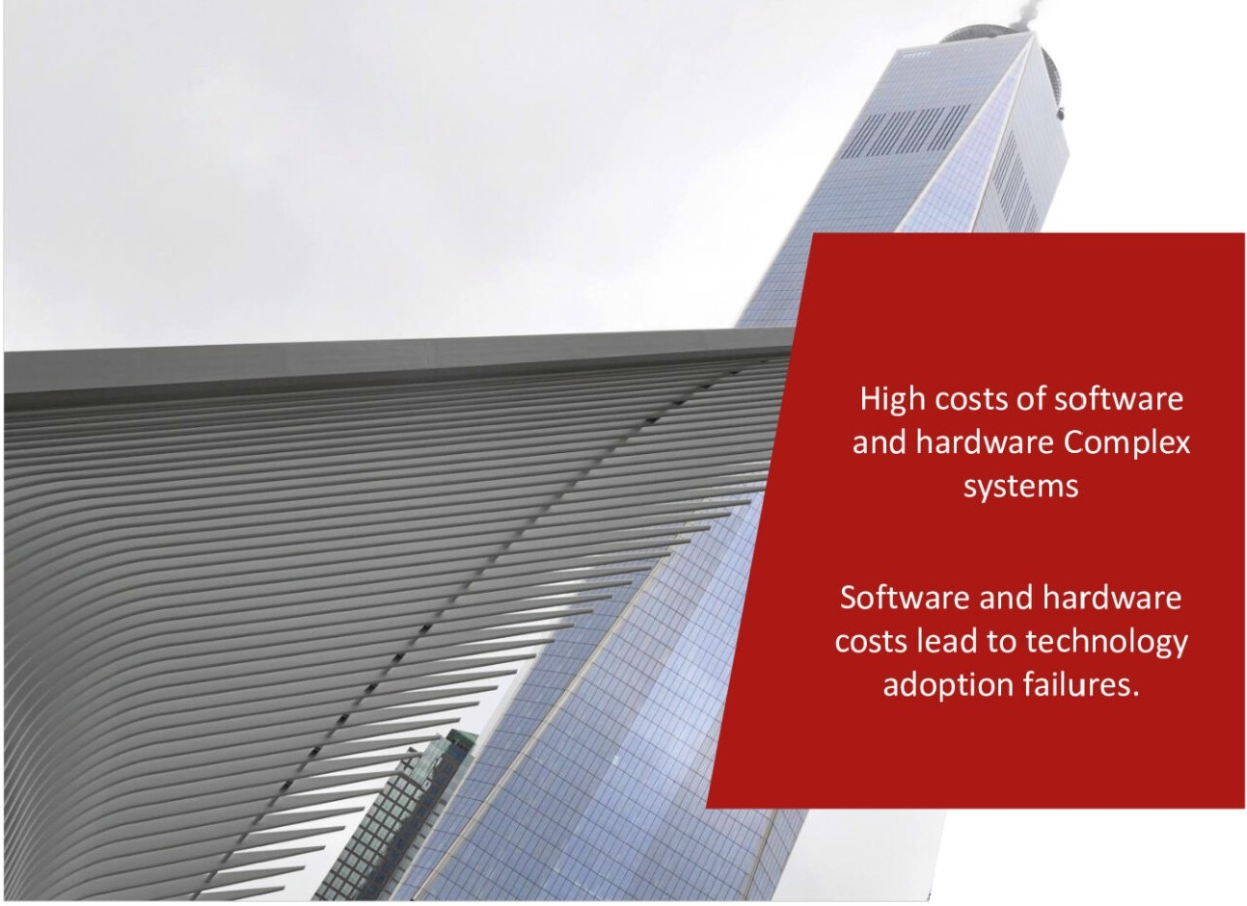


New Te c h no logy
Traditional methods may make it difficult to adjust to new technology-based tools and platforms that can improve efficiency and streamline processes.
foh.o•3
ORACLE
NETSUITE
Alliance Partner

Slide 7
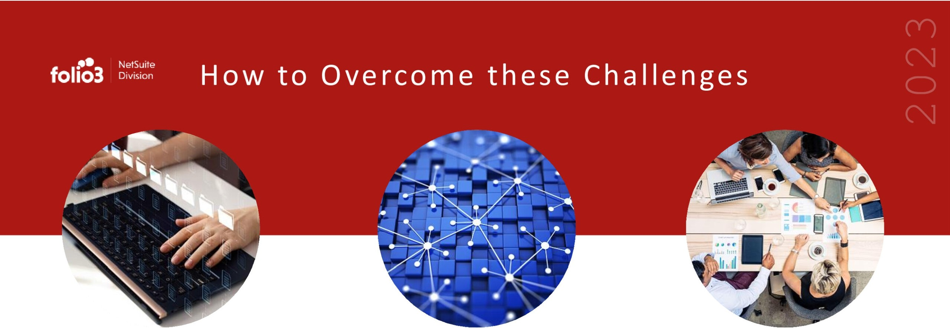
Implement Automated Processes
Improved Communication
Emphasize Data-driven Decision-Making
Such as rent collection and maintenance tracking can save time and reduce the risk
Improving communication with tenants and
Collect ing and analyzing data about properties and
property owners through regular updates and access to online portals can increase transparency and improve relationships.
tenants can help property owners and managers make more informed decisions about property management.
of errors.

Slide 8
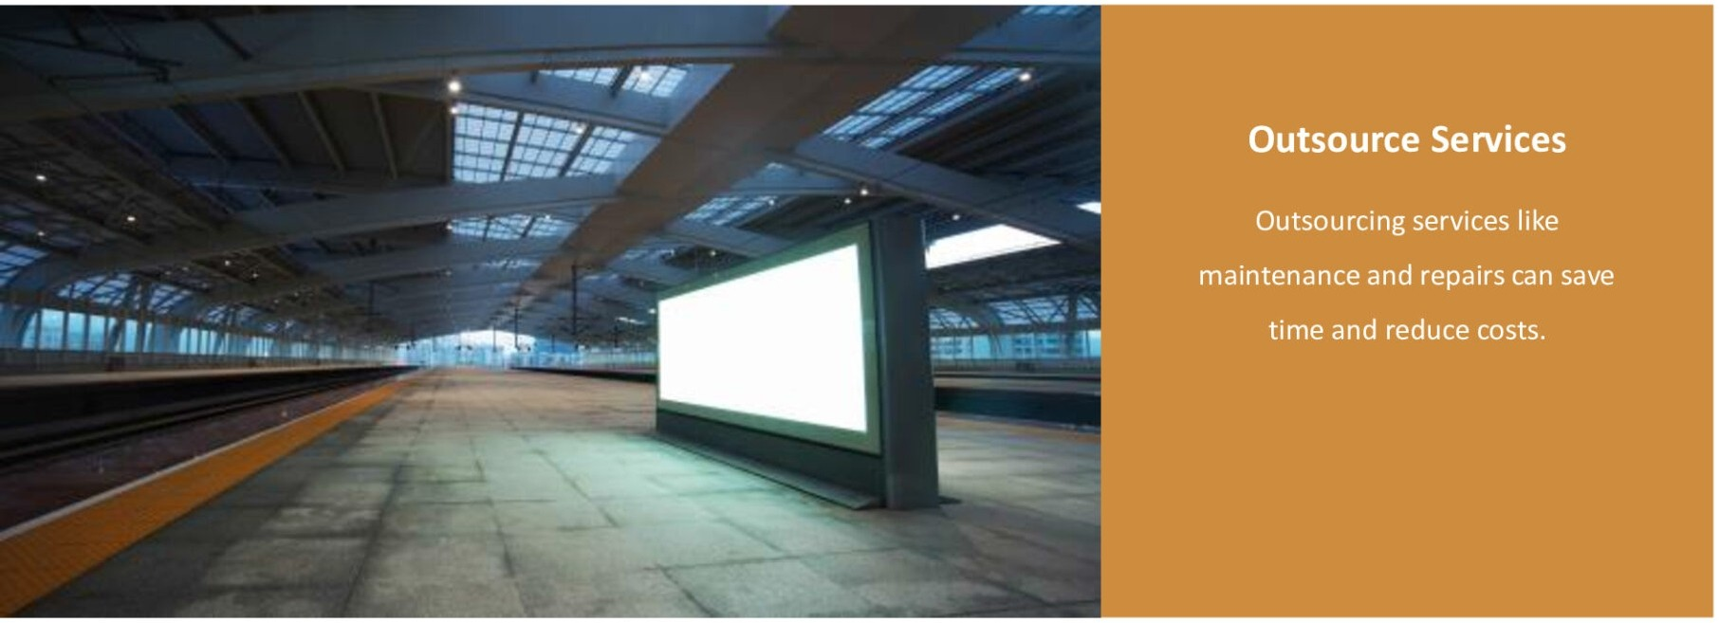
Embrace Technology
Implementing new techno logy­
based tools and platforms,such
as property management
software and online
communication platforms.
Stay up-to-date with industry trends
Prioritize preventive maintenance
Keeping up-to-date with the latest industry trends and best practices can
A preventative maintenance plan can help prevent costly repairs and prolong the property's lifespan.
help property owners and managers stay competitive and provide the
best possible service to their tenants.
foh.o•3
ORACLE NETSUITE
AJJ\ance Partner

Slide 9
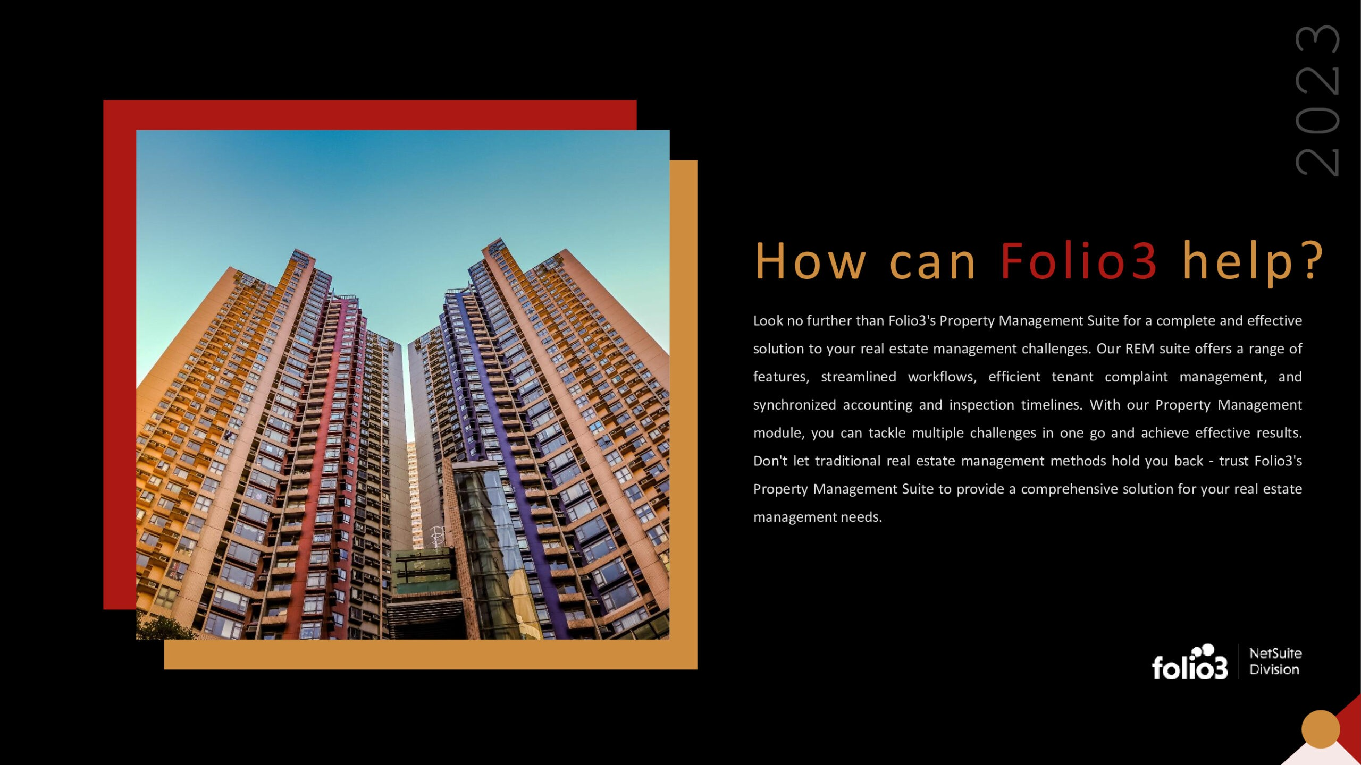

Slide 10

fol1.0•3
ORACLE
NETSUITE
ADlance Partner
./ Automate manual processes like rent collection and maintenance tracking to save time and reduce errors.
./ Provide online portals for tenants and property owners to access important information,such as lease agreements, rental payments, and maintenance requests.
,/ Implement preventive maintenance plans to help prevent costly repairs and prolong the property's lifespan .
./ Analyze data about properties and tenants to make more informed decisions about property management.
./ Implement marketing tools to help property managers market vacant properties to potential tenants .
,/ Provide property managers mobile access to important information,such as tenant histories and maintenance records.
./ Offer support and training to help property managers make the most of the software solutions.

Slide 11
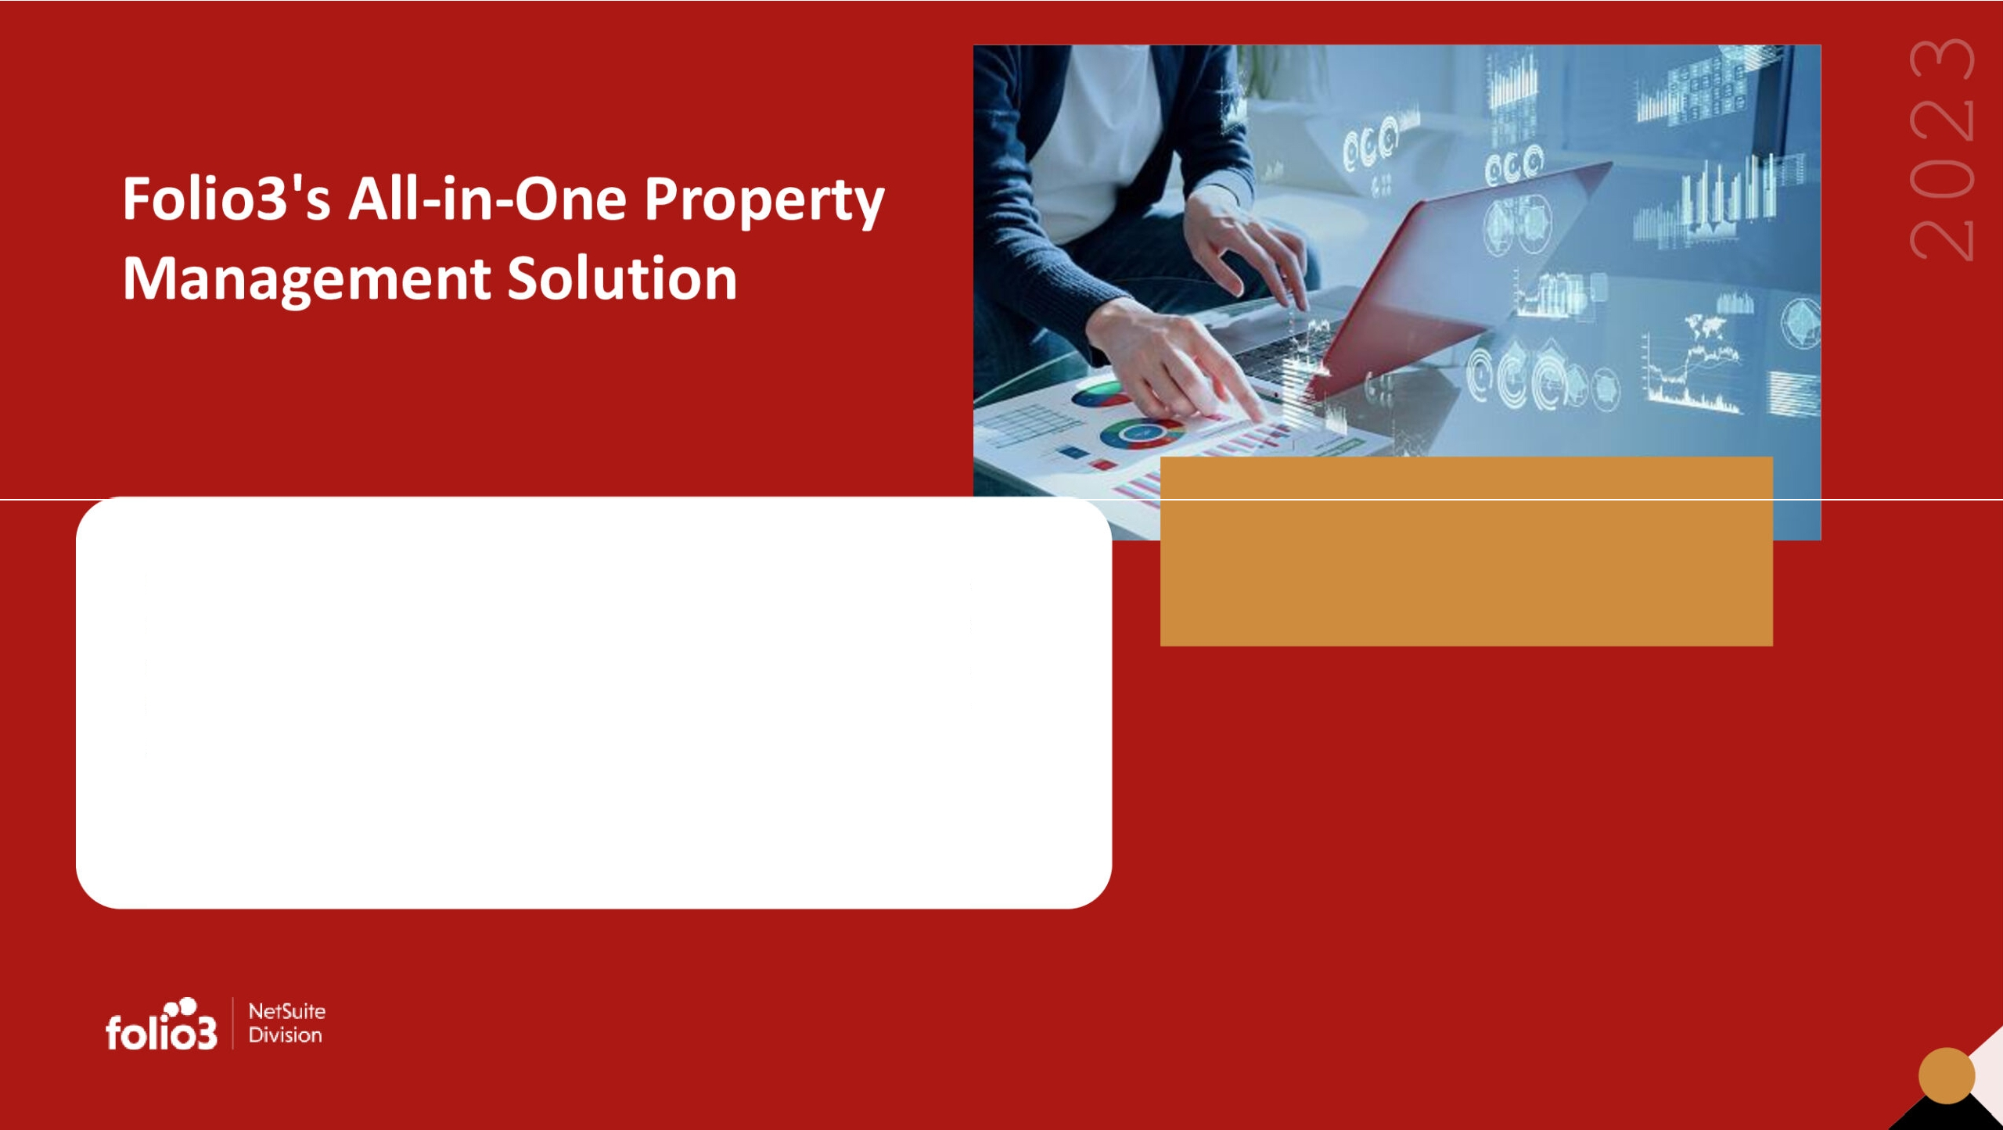
Folio3's SaaS-based property management system is fully integrated with Oracle NetSuite ERP, providing a comprehensive solution for real estate business owners and property managers. Our specialized Property Solution streamlines data automation, financial management, leasing, maintenance, tenant management, and more - optimizing property management and enhancing tenant and manager relationships.

Slide 12


foh.o•3
ORACLE
NETSUITE
AJllanc:e Partner
About NetSuite
Property management companies can benefit from Folio3's NetSuite ERP solution, which can help them run their business more efficiently, leading to enhanced tenant experiences and increased profitability. The solution provides comprehensive features to manage financial operations, accounting, property leases, rent schedules, service requests, and maintenance schedules. With these tools, property managers can have better visibility and control over their business processes, enabling them to make informed decisions to optimize their performance.

Slide 13

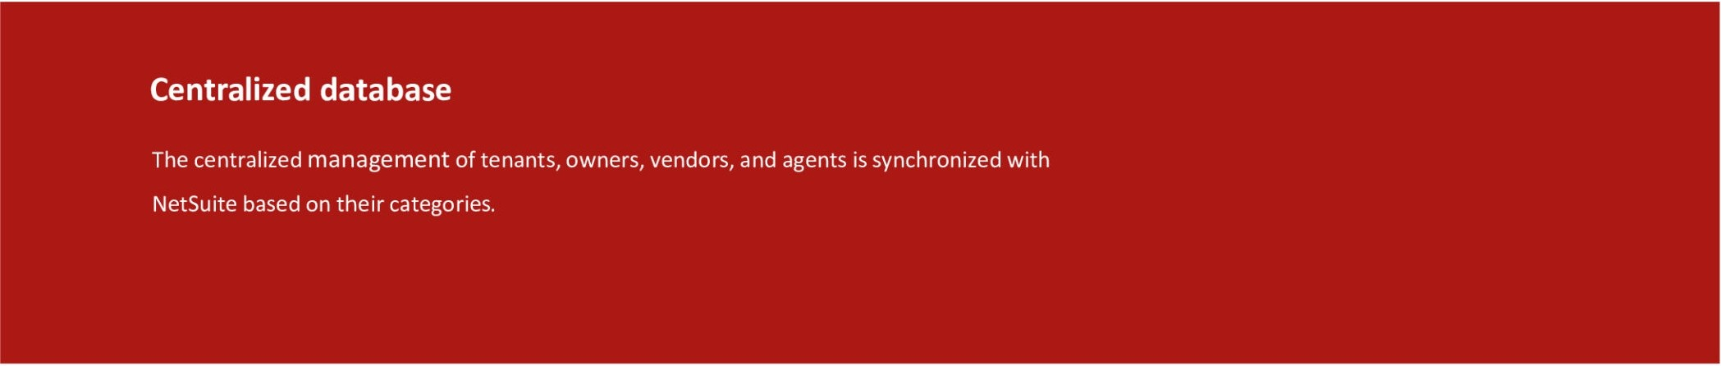
foh.o•3
ORACLE
NETSUITE
Alliance Partner
Features
Management Of Contractual Agreements
Management of a contract from start to finish, including the application drafting stage,move-in,and move-out.

Slide 14
foh.o•3
ORACLE NETSUITE
Alllanc.e Partner

Slide 15
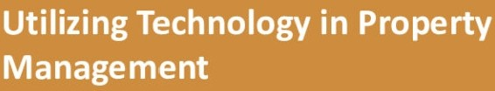
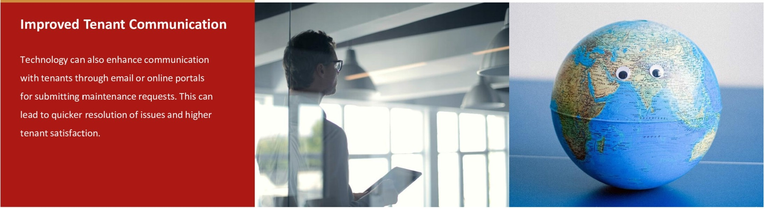
foh.o•3
ORACLE
NETSUITE
Altiance Partner
......
. .
Benefits
- -.-
..
tasks such as rent collection, mai
.. increasing overall efficiency.
ifhis can save time and reduce

Slide 16


foh.o•3
ORACLE
NETSUITE
Alliance Partner
Cost Reduction
By automating processes and reducing manual labor,technology can help property owners and managers save money on administrative costs and reduce the need for additional staff, ultimately leading to cost savings.
Data Access
Technology enables property owners and managers to manage their properties remotely,which is especially beneficial for managing properties in multiple locations. This can enhance convenience and flexibility,allowing property owners to manage their properties from anywhere efficiently.

Slide 17
Convenience and Flexibility
Technology enables property owners and managers to manage their properties remotely, which is especially beneficialfor managing properties in multiple locations.This can enhance
convenience and flexibility,allowing property owners to eff iciently manage their properties
from anywhere.
More Security
Technology can improve security by providing features such as online payments,digital lease signing,and secure portals for submitting sensitive information,giving property owners and
tenants peace of mind.
foh.o•3
ORACLE
NETSUITE
Alllance Partner

Slide 18

W ho Ca n Be nef it Fro m
Fo lio 3's Pro pe rty
Ma na ge me nt So lut io n ?
Our Real Estate Management Solution is an excellent choice for businesses that need help with contract and tenant management or find it challenging to handle daily property administration tasks. By implementing our solution, such companies could save countless hours of valuable time.
foh.o•3
ORACLE
NETSUITE
Alliance Partner

Slide 19


foh.o•3
ORACLE
NETSUITE
Aliance Partner
Co nc lus io n
Folio3's Property Solution can help property managers and landlords streamline operations,maximize profits,and mitigate legal risks.With its
integration with Oracle NetSuite ERP,the property solution provides a robust and reliable solution for managing Real Estate properties.

Slide 20


Slide 21


