Slide 1
Boosting Sales and Customer Experience: NetSuite Amazon Integration Insights

Slide 2
Table of Content
Understanding NetSuite And Amazon Integration Company Profile
Benefits Of Integrating NetSuite With Amazon For Sales And Customer Experience
Enhancing Sales through NetSuite Amazon Integration
Improving Customer Experience with NetSuite Amazon Integration
Folio3’s NetSuite Connector Highlights

Slide 3
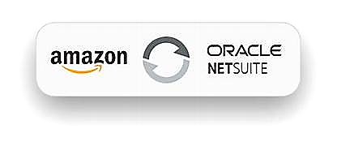
Understanding NetSuite And Amazon Integration
NetSuite Amazon Integration allows you to streamline order and Inventory management. You can sync your Amazon Seller Central and NetSuite accounts effortlessly. It lets you easily manage orders and inventory availability while ensuring accurate and up-to-date data across multiple Amazon marketplaces.

Slide 4
Automated integration between NetSuite and Amazon.
Customizable to align with your business processes
Benefits Of Integrating NetSuite With Amazon For Sales And Customer Experience
Support for both FBM and FBA listings and transactions.
Optional post-go-live support is available.

Slide 5
Features And Capabilities
Automatic transfer of orders and customer data.
Synchronization of order cancellations between Amazon and NetSuite.
Support for Fulfillment by Merchant (FBM) and Fulfillment by Amazon (FBA) order types.
Automatic publishing of item listings.
Easy delisting of items from Amazon directly within NetSuite.
Efficient management of inventory quantities between NetSuite and Amazon.
Creation of FBA transfer orders and inventory transfers from NetSuite.
Support for various NetSuite item types, with customization options available.
Comprehensive coverage of Amazon item categories.
Synchronization of fulfillment status, shipping data, carriers, and tracking.
Automatic synchronization of invoices.

Slide 6
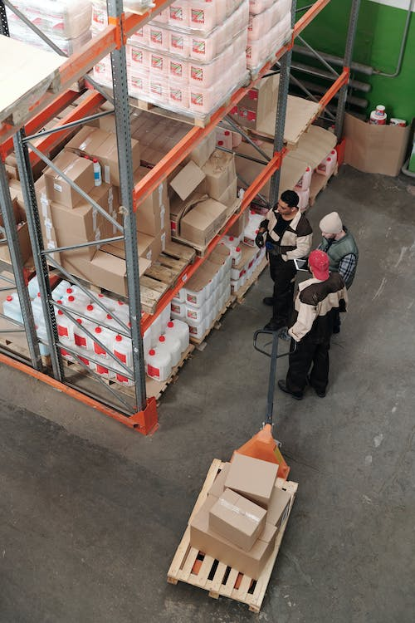
Enhancing Sales Through NetSuite Amazon Integration
Centralized Order Management
Streamline order processing by managing all orders from Amazon within NetSuite.
Optimized Inventory Management
Gain better control over inventory levels and availability.
Pricing and Promotions
Easily manage pricing and promotional activities on Amazon.

Slide 7
Accurate Product Information
Ensure customers can access up-to-date and accurate product information.
Order Tracking
Improving Customer Experience with NetSuite Amazon Integration
Enable customers to track their orders easily.
Enhanced Customer Support
Streamline customer support processes by integrating Amazon order data with NetSuite.
Leveraging Feedback and Reviews
Utilize customer feedback and reviews from Amazon to gain valuable insights.

Slide 8
Planning and Setup
Define integration objectives and goals.
Familiarize yourself with Amazon Marketplace APIs.
Choose a reliable integration solution.
Map data between systems.
Best Practices For Successful NetSuite Amazon Integration
Integration Execution
Automate order processing from Amazon to NetSuite.
Sync inventory levels between NetSuite and Amazon.
Ensure pricing consistency across sales channels.
Monitor and reconcile financial data.
Implement error handling and logging.
Testing, Training, and Optimization
Thoroughly test and validate the integration.
Provide user training and ongoing support.
Regularly review and optimize integration performance.

Slide 9
How Does Folio3 Help You To Overcome Those Challenges?
Data and Integration Management
Data mapping and structure alignment between NetSuite and Amazon.
Handling integration complexity and multiple systems.
Ensuring scalability for high order volumes.
Inventory and Pricing Management
Implementing robust inventory management processes.
Coordinating pricing and promotions across platforms.
Testing, Support, and Security
Thorough testing and validation of the integration.
Ongoing maintenance, updates, and support.
Aligning business processes with the integrated system.

Slide 10
Efficient Inventory Management
Folio3’s NetSuite Connector Highlights
Keep accurate inventory levels synced with Amazon to prevent stock issues.
Order Handling
Synchronize and manage sales orders effortlessly between Amazon and NetSuite.
Shipment Updates
Provide customers with timely tracking information for enhanced transparency.
Consistent Product Information
Ensure customers see up-to-date details like pricing, colors, and descriptions.
Smooth Refund Process
Minimize customer dissatisfaction with prompt and seamless refund handling.
Easy Deployment
Get your integration up and running quickly and smoothly.
Comprehensive Visibility
Monitor the integration status and synchronize data for better control.

Slide 11
About Folio3
NetSuite Alliance Partner for Implementing, Customizing & Integrating NetSuite

Slide 12
Get in Touch
Experience seamless synchronization between your Amazon marketplace and NetSuite with the powerful Folio3 NetSuite Amazon Connector. Focus on growing your business without the hassle of manual data entry.
+1 (408) 365-4638
netsuite.folio3.com
netsuite.sales@folio3.com

Slide 13
THANK YOU

